Slide 1
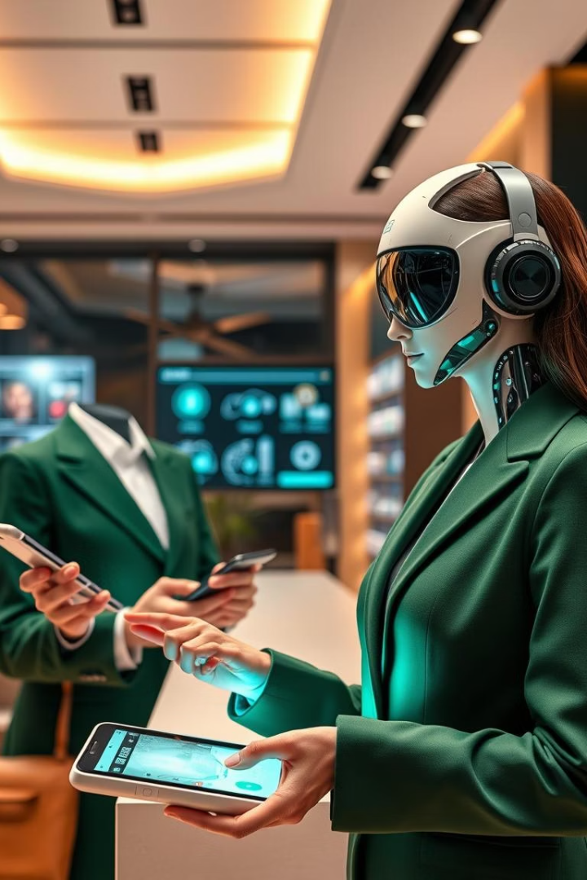
SmartPitch AI: AI-powered Product Recommender for GroMo Partners
FinArva AI 2025 Theme 1 Submission by Team Pixel Coders

Slide 2

Challenges Faced by GroMo Partners
Decision Paralysis
Low Conversion Rates
Limited Guidance
Agents unsure which product to pitch
Irrelevant pitching wastes effort and cuts commissions
Lack of real-time, context-driven suggestions

Slide 3
Introducing SmartPitch AI
Inputs
Outputs
Customer Age Group
Best-fit Product Recommendation
Location
Personalized Pitch Line
Past Purchases

Slide 4





User Journey with SmartPitch AI
Open the App
Access SmartPitch AI easily on mobile
Select Details
Input Age, Location, Past Purchases
Click Recommend
Generate product & pitch instantly
Receive Suggestion
Get tailored product recommendation

Slide 5

Why SmartPitch AI Will Succeed
Increased Relevance
Confidence Boost
Higher conversion rates
Faster, more accurate pitching
10–15% Income Uplift
More commissions for agents
Operates without backend API, mobile-friendly, and privacy respecting.

Slide 6
Meet Team Pixel Coders
Aman Tripathi – Frontend & Integration
Navnit Bihari – Backend & Data Logic
Anam Aaliya – Design & Documentation
Alok Kumar Jaiswal – Product Flow & QA
MD Kamran – Research & Pitch Narrative

Slide 7
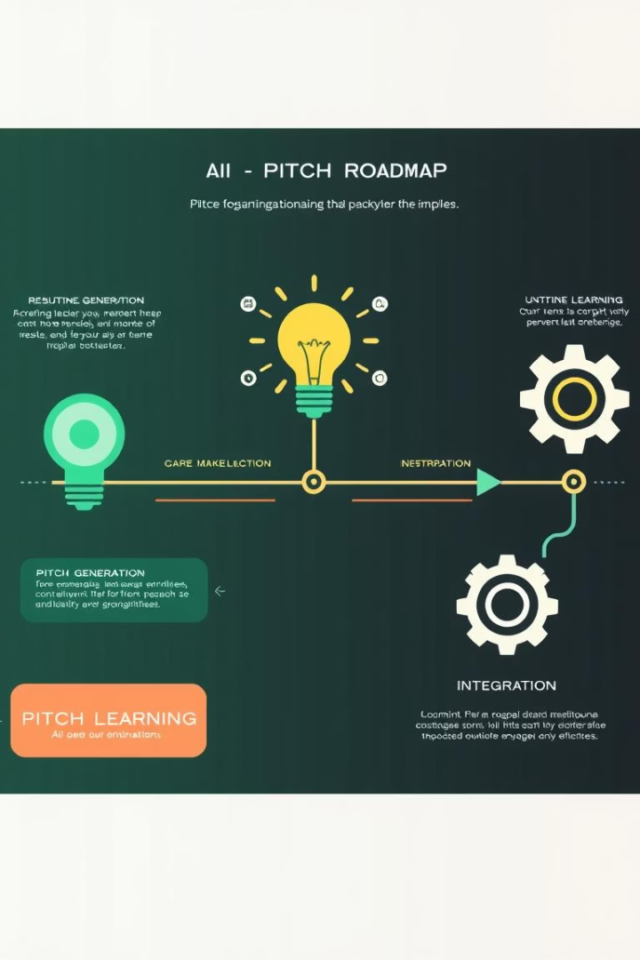
Our Vision: Future Roadmap
1
Phase 2
GPT-powered pitch generation, multilingual support
2
Phase 3
ML-driven product recommendations, behavior based ranking
3
Phase 4
WhatsApp assistant, live pitch help, dashboard goals

Slide 8

Thank You
SmartPitch AI empowers GroMo agents with smart, AI-driven sales support.
Built for real results: sell better, faster, and smarter.
Team Pixel Coders 🙌

